Slide 1
Basic CNN

Slide 2
Fully Connected Network
From 2D to 1D
Lose spatial features
Too many network parameters
Hard to train(gradient vanishing/exploding)

Slide 3
Keep the 2D features
2D Image input(1 or 3 channels), can be treated as multi-dimension tensors
Convolve input with kernels
Create 3rd tensors (feature maps) as learnable parameters
Reduce size
Less parameters and easier to train

Slide 4
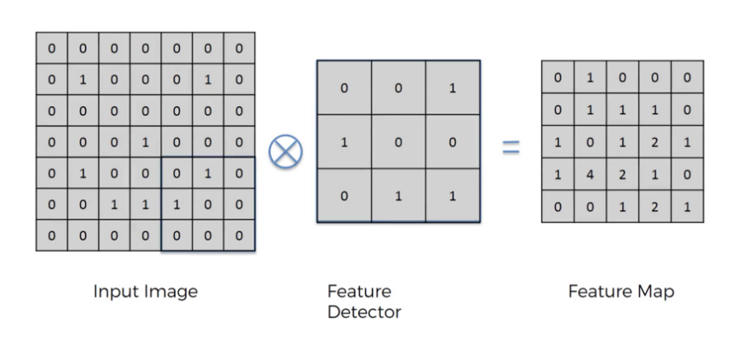
Convolution

Slide 5
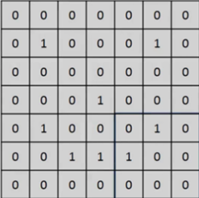
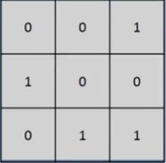
3-Channel Convolution

Slide 6
Convolution
Convolution is a mathematical operation on two functions
To produce a third function that expresses how the shape of one is modified by the other.
The term convolution refers to both the result function and to the process of computing it. Convolution is similar to cross-correlation
Convolution preserves the spatial relationship between pixels by learning image features using small squares of input data.
Could loss some affine features(can use STN)

Slide 7
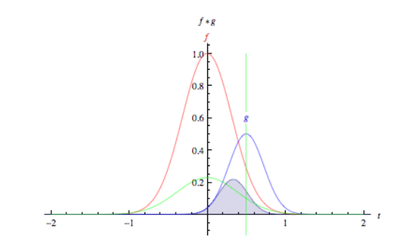
Convolution

Slide 8
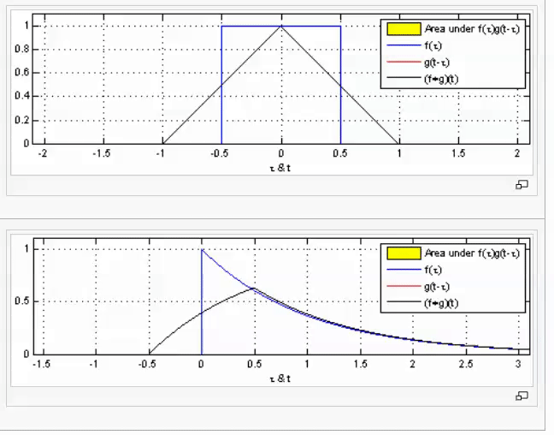
Two functions convolve

Slide 9
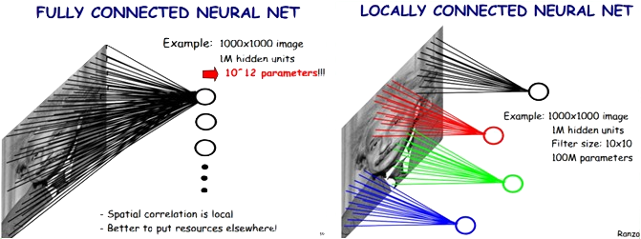
Locally Connected Features

Slide 10

Two images convolve

Slide 11
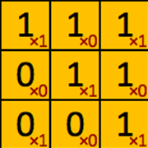
filter‘ or ‘kernel’ or ‘feature detector

Slide 12
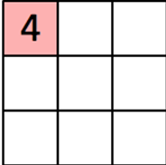
Convolved Feature’ or ‘Activation Map’ or the ‘Feature Map‘

Slide 13
Covolutional Neural Network

Slide 14

Convolution Neural Network
http://parse.ele.tue.nl/cluster/2/CNNArchitecture.jpg

Slide 15
CNN Layers
Convolution
Non-Linear(Relu for example)
Pooling or sub sampling( Max Pooling for example)
Classification (Fully connected)

Slide 16
Convolutional Layers

Slide 17
Input Image
Kernel(Filter),
Feature Map(Output Volume)

Slide 18
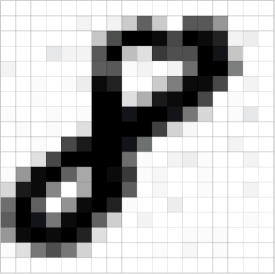
An Image is a 2D matrix

Slide 19
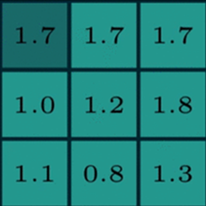
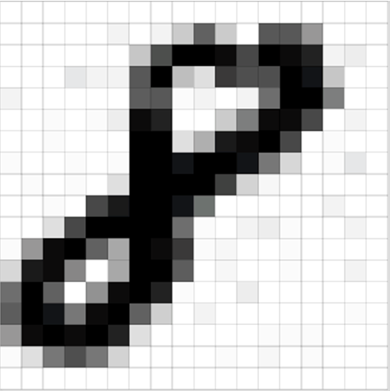
Two maxtrics interact
Reception field
A kernel(filter, neuron)
Numbers: weights

Slide 20
Two maxtrics interact
Sliding

Slide 21
Two maxtrics interact

Slide 22
Two maxtrics interact

Slide 23

Kernel(Filter)
255
200
0
*
=
155
55
35
???
55
10
5

Slide 24
Two maxtrics interact

Slide 25
Two maxtrics interact

Slide 26
Two maxtrics interact

Slide 27
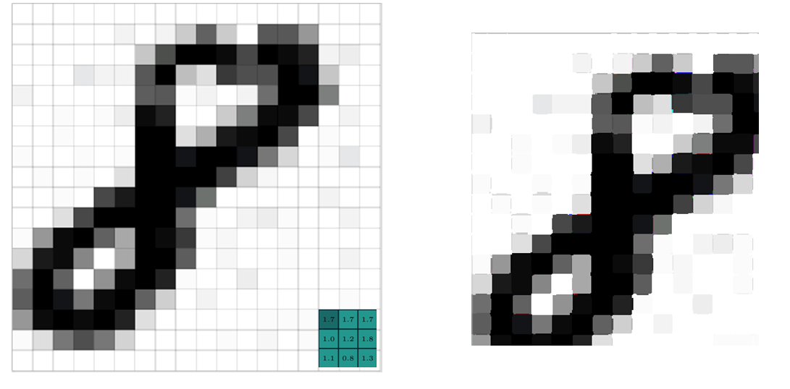
Generate a new image
32 X 32 X 3
3x3x3
Feature Map
(Activation Map)
(Output Volume)
30 X 30 X 3

Slide 28

Generate a new image

Slide 29
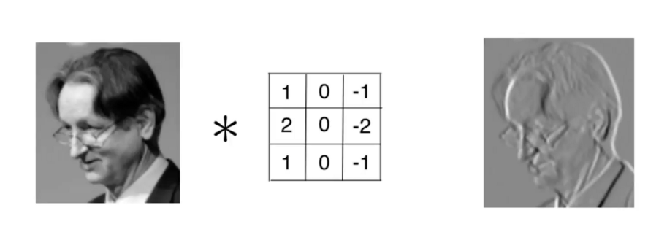
Kernel is used as Feature Detector

Slide 30
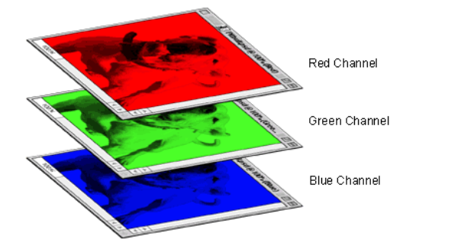
A colored image is 3 x 2d matrix

Slide 31
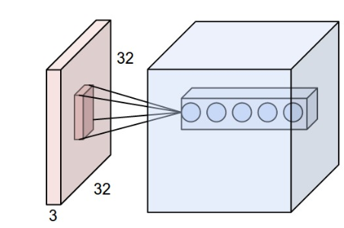
Convolve in 3D(32x32x3) Input Image
Every kernel should be (mxmx3) size
The kernel slide over the xy plane with same depth(3)
The product of 3D image and 3D kernel is still a 2D plane.
The output volume is the stack of all planes created by all kernels.
In this example the output volume is nxnx5 dimension.

Slide 32
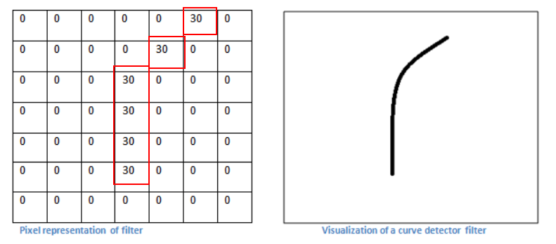
A filter is just a feature identifier

Slide 33
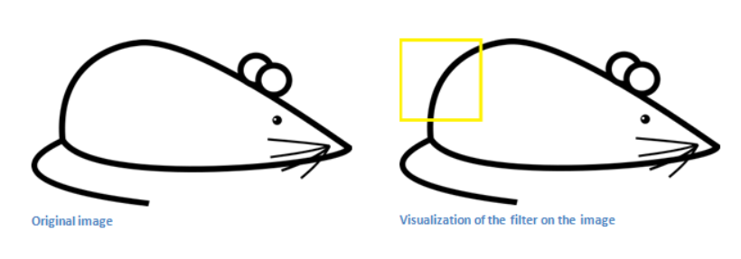
Filter on a part of an image

Slide 34
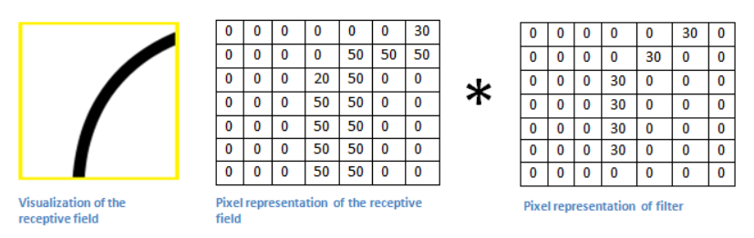
Just matrics multiplication

Slide 35
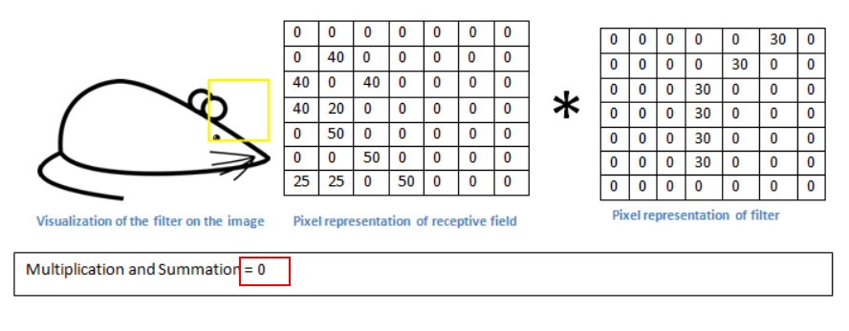
Without the feature

Slide 36
Filters = Feature Detectors
A filter for a unique feature.
Millions of filters in a convolutional network
Higher number ‘fires’ means the feature is detected
So many different feature detectors for different features.

Slide 37
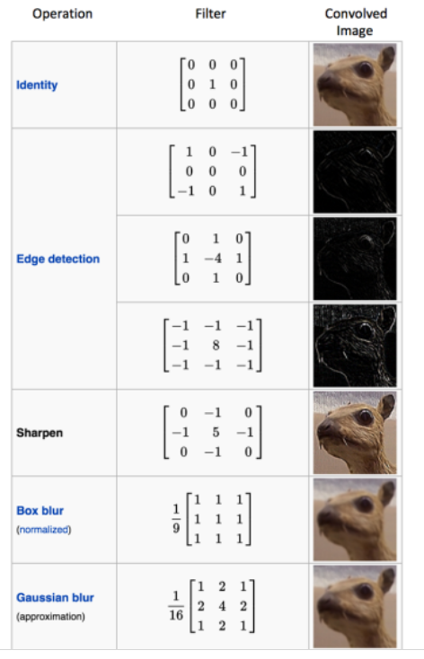
Different filters can detect different features from an image

Slide 38
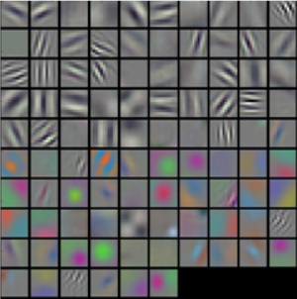
Filters = Feature Detectors

Slide 39
Layers that extract features
Earlier layers extract low level object like curves and edges.
We need the network to recognize higher level features such as hands, or paws or ears.
Different neurons in each layer are representing a feature to detect different objects, like faces, texts.

Slide 40
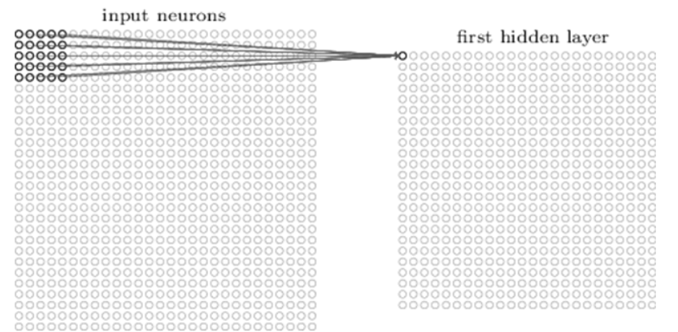
Learnable parameters(w, b)
A first layer neuron:
The number of weights is 5x5x1(Kernel dimension ) + 1 bias.

Slide 41
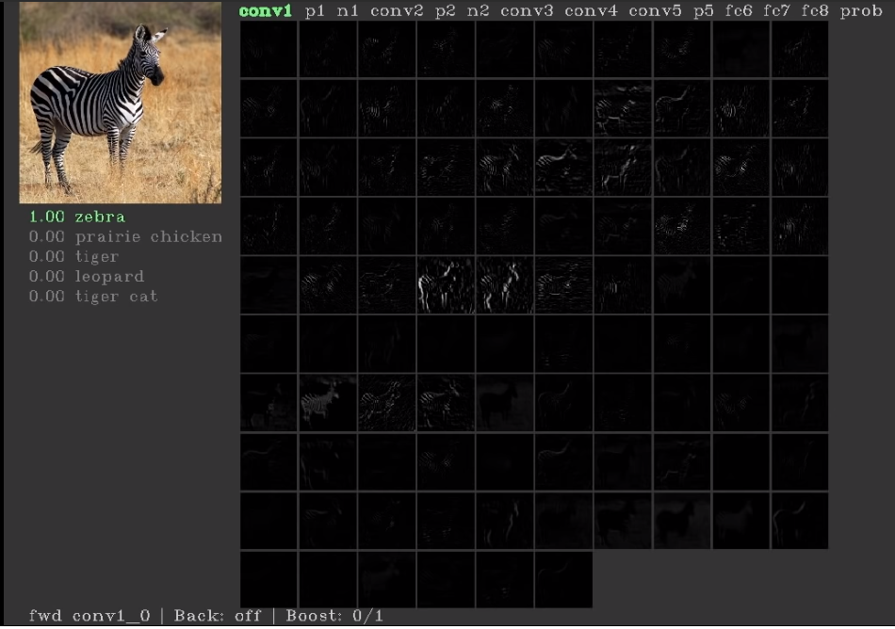
First layers’ neurons for basic features(conv1)

Slide 42
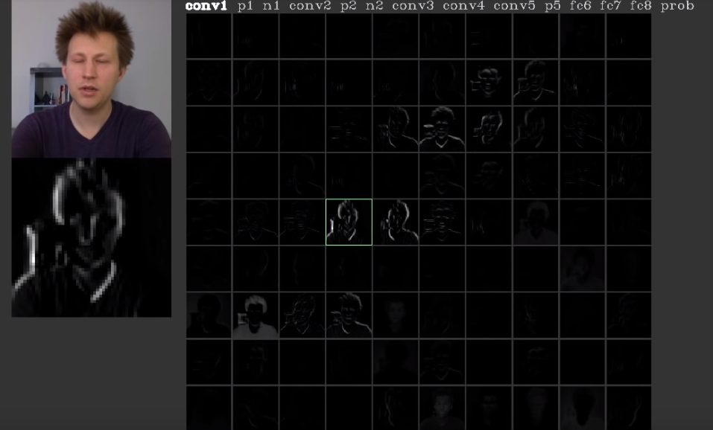
First layers’ neurons for basic features(conv1)

Slide 43
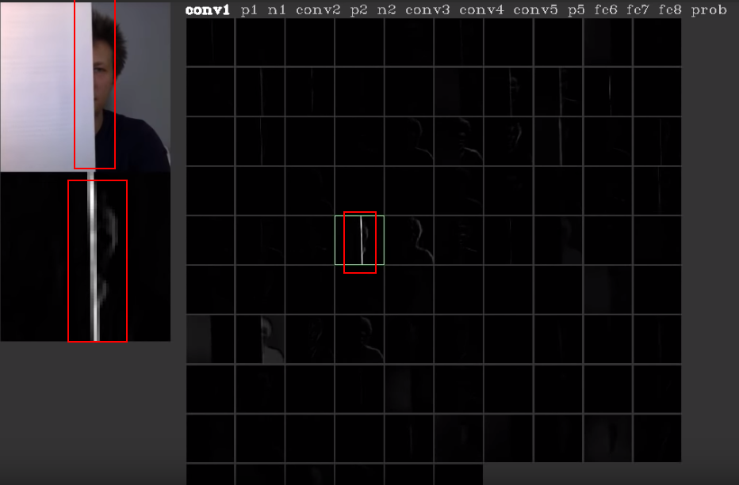
The neuron is for edges

Slide 44
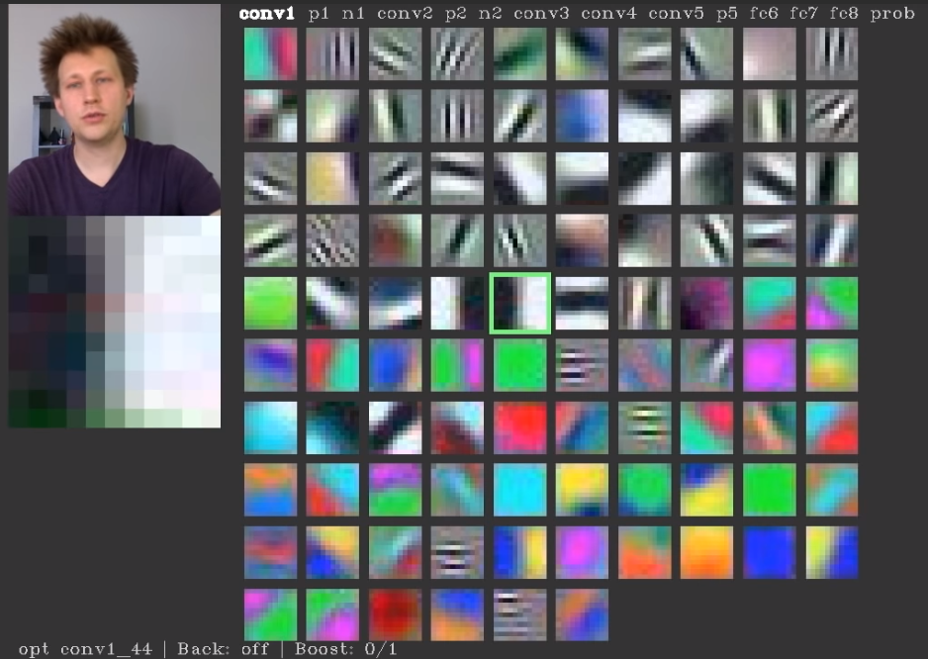
Every neuron is looking for something

Slide 45
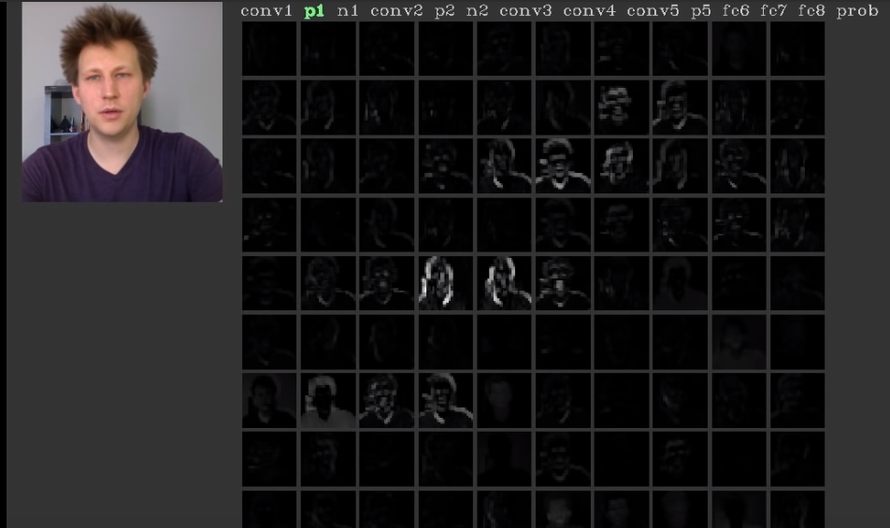
Pooling layer

Slide 46
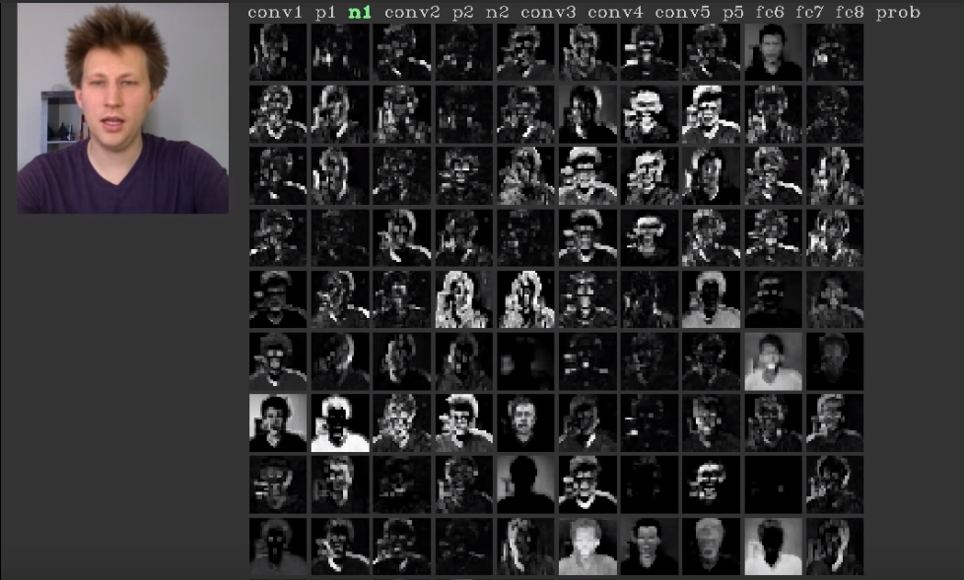
Normalise layer

Slide 47
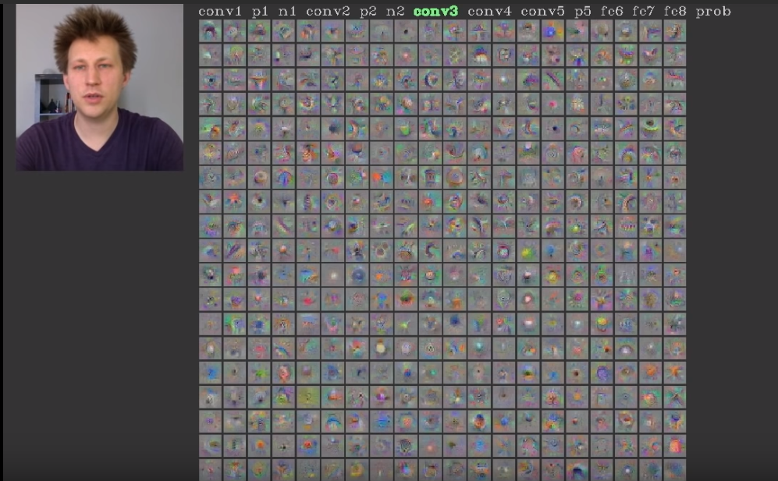
Con3 layer

Slide 48
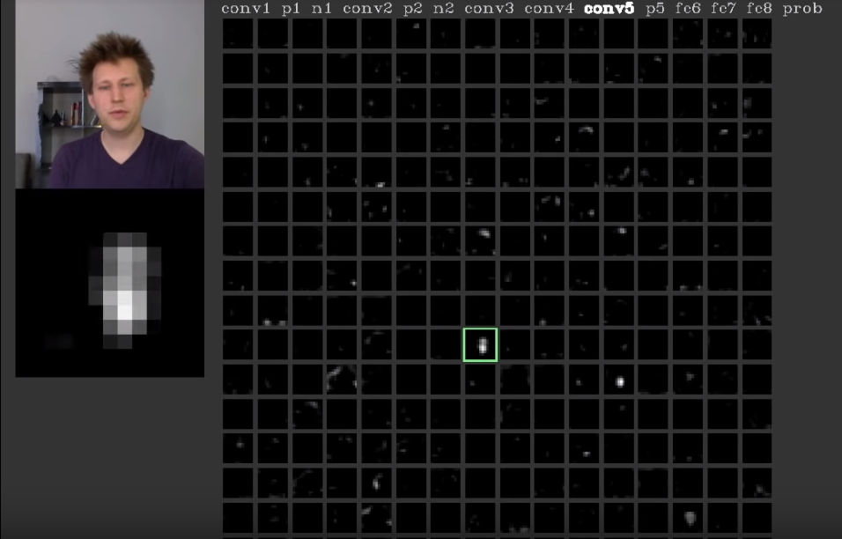
Neuron in con5 layer is for faces

Slide 49
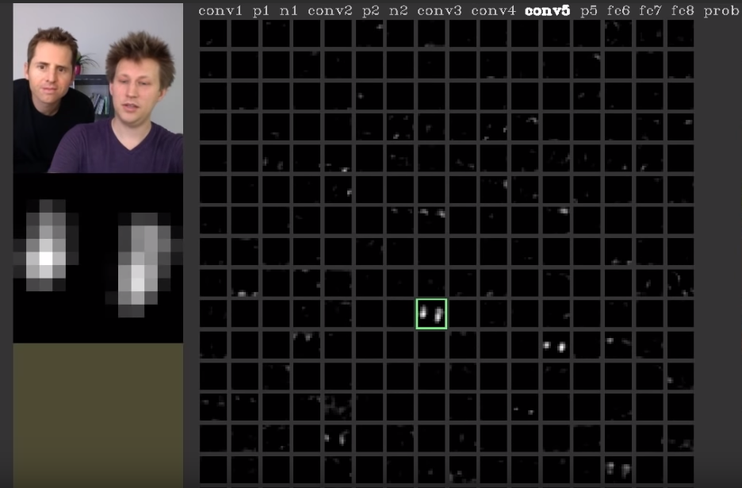
Neuron in con5 layer is for faces

Slide 50
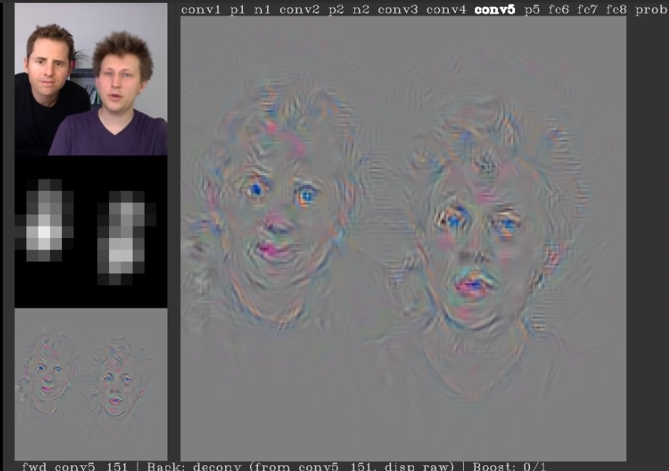
Neuron in con5 layer is for faces

Slide 51
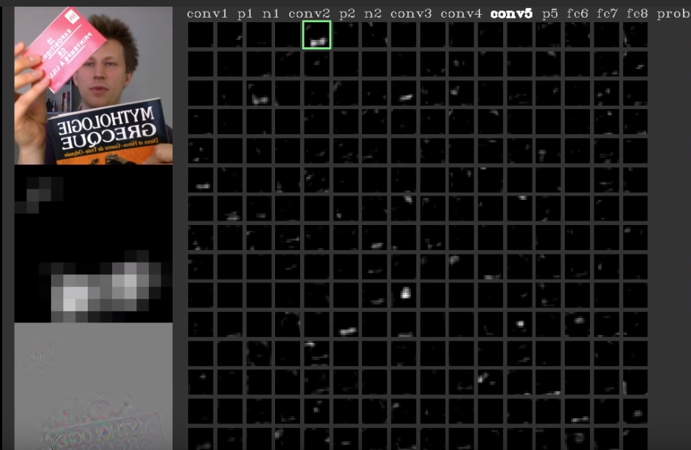
Neuron in con5 layer is for printed texts

Slide 52

Convolution operation captures the local dependencies in the original image

Slide 53
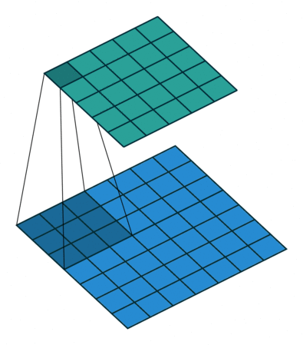
Convolution in Action

Slide 54
Relu Layers

Slide 55
Relu Layers
Added after every convolutional layer.
As non-linear layer(activation layer)
Since all conv layers are doing linear computing.
Used to use tanh and sigmoid.
Relu is faster.
f(x) = max(0, x)

Slide 56
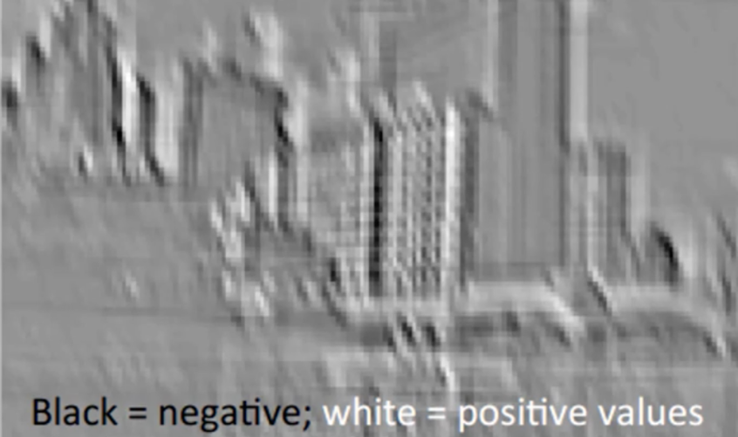
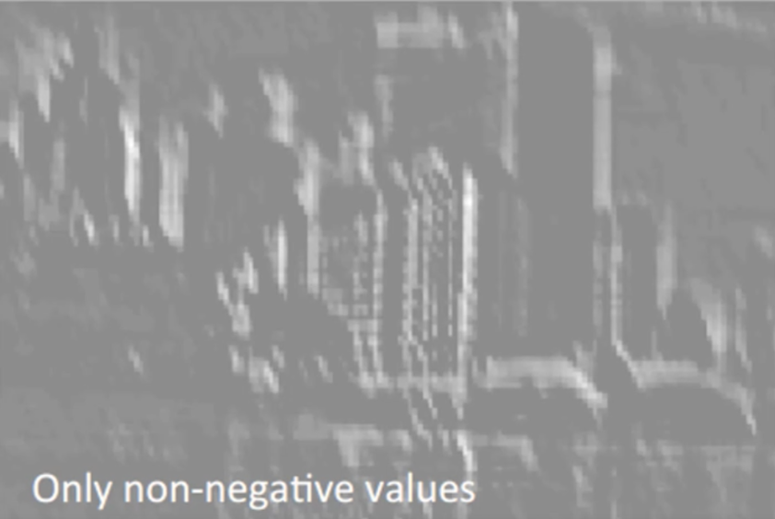
Relu, delete negative(black)

Slide 57
Size of featured map
Depth
Stride
Zero-padding
https://github.com/vdumoulin/conv_arithmetic

Slide 58
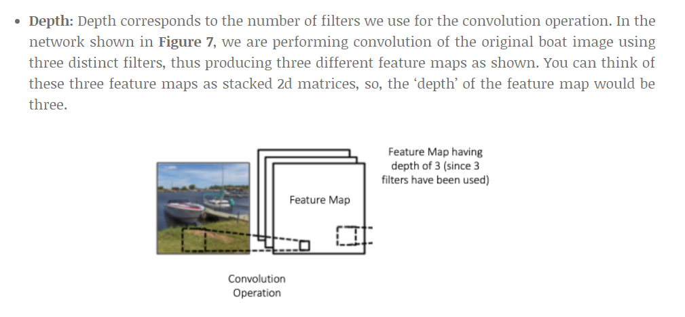
Depth(Number of filters)
https://github.com/vdumoulin/conv_arithmetic

Slide 59
Stride
Between how many cell we move the kernel.
Bigger stride, smaller output image.
Usually less than 3.

Slide 60
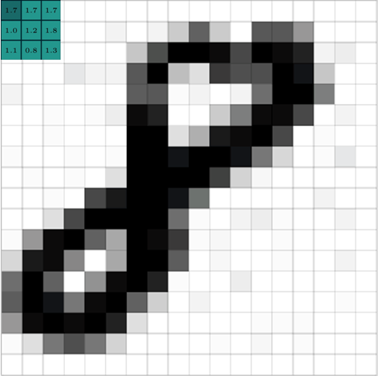
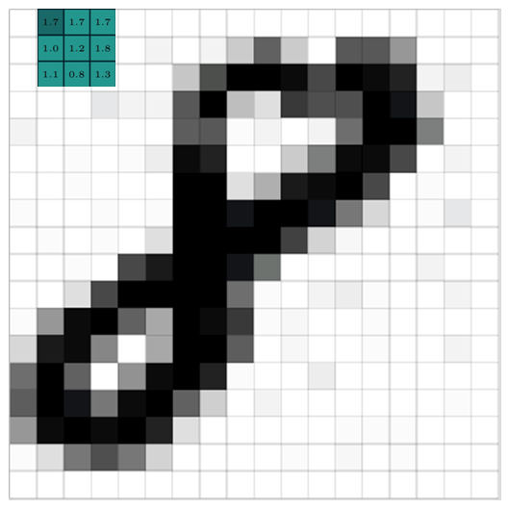
Stride = 1

Slide 61
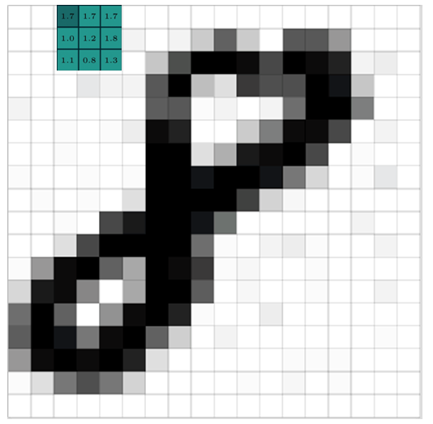
Stride = 2

Slide 62
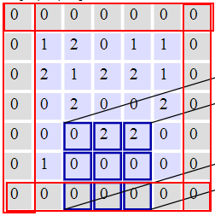
Zero Padding
Pad cells around an image
Could be any size
Usually 0-2
Purpose is to keep the output map the same dimension as input map.

Slide 63
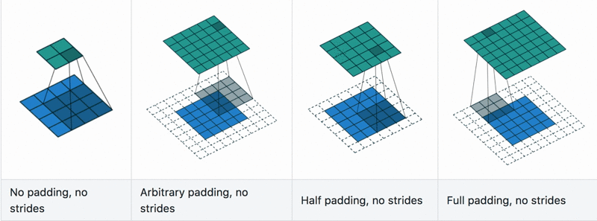
Convolution with padding in Action
https://github.com/vdumoulin/conv_arithmetic

Slide 64
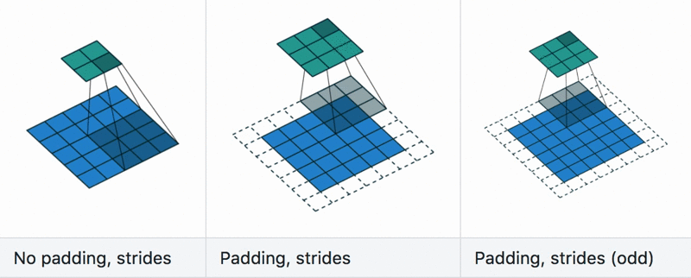
Convolution with stride+padding in Action
https://github.com/vdumoulin/conv_arithmetic

Slide 65
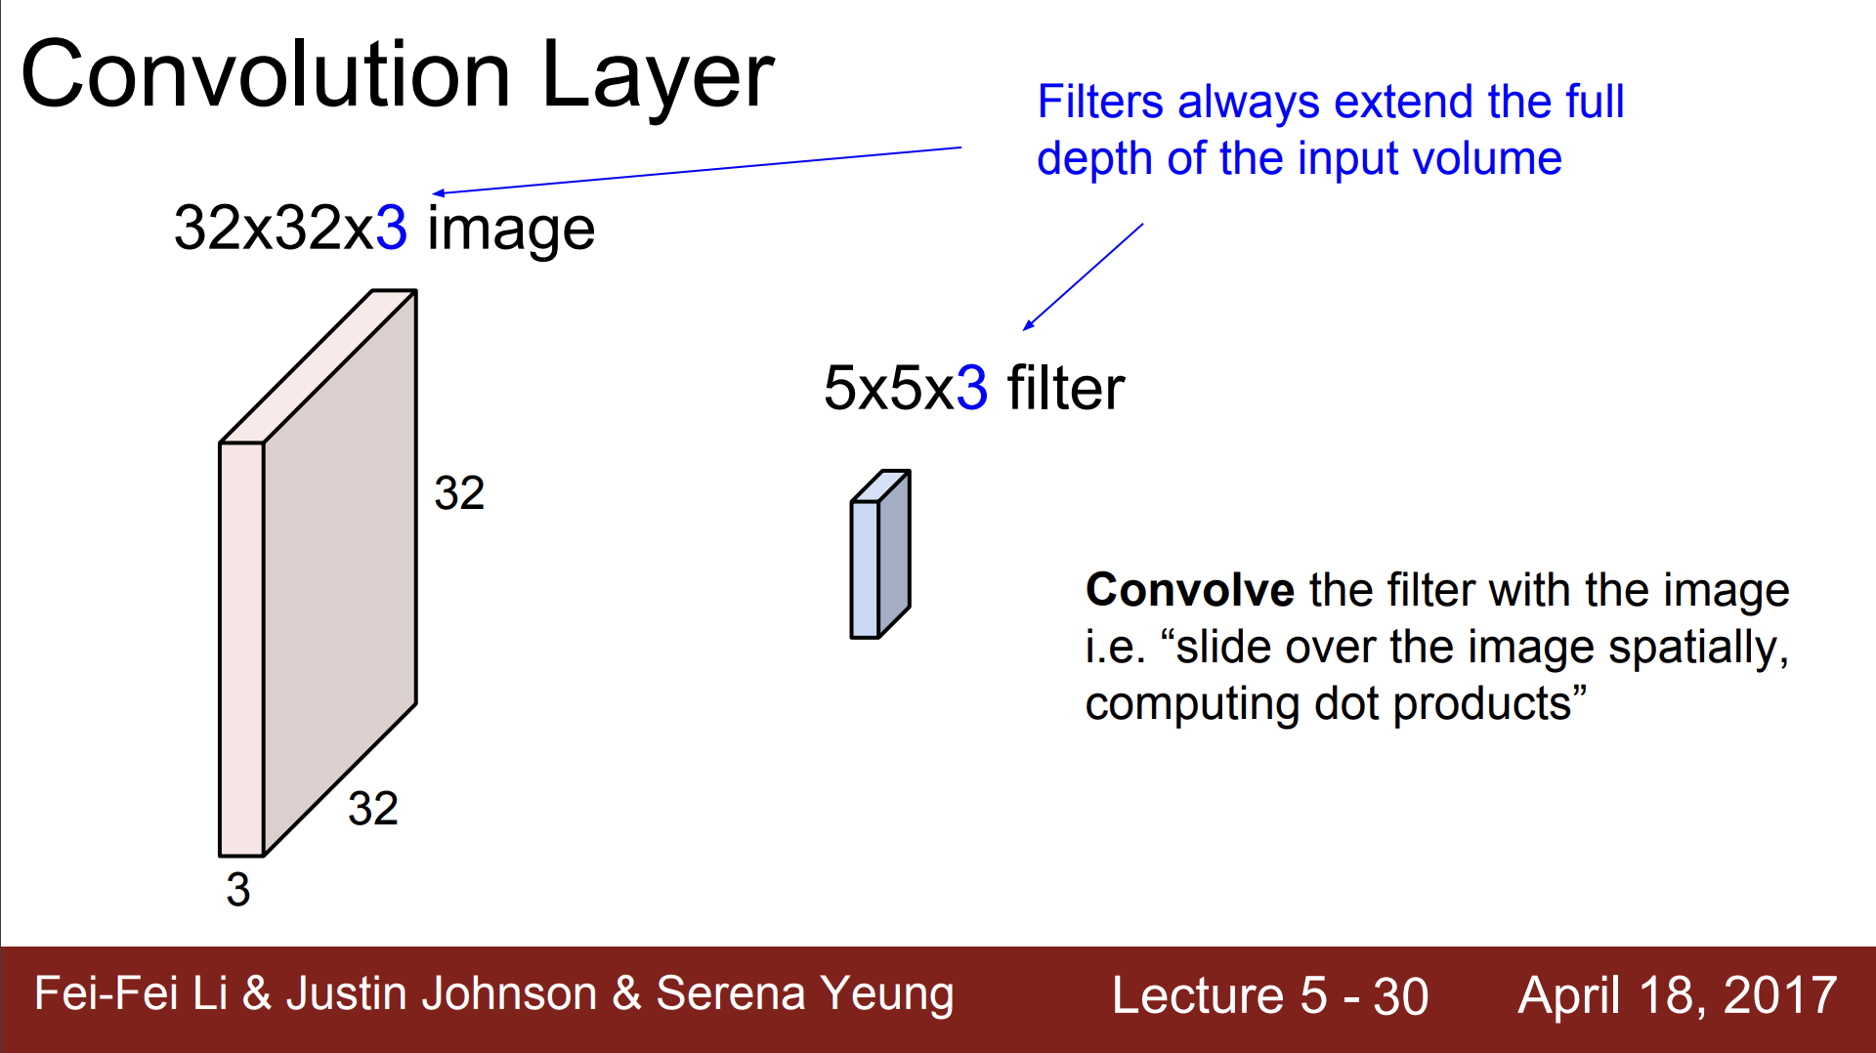

Slide 66
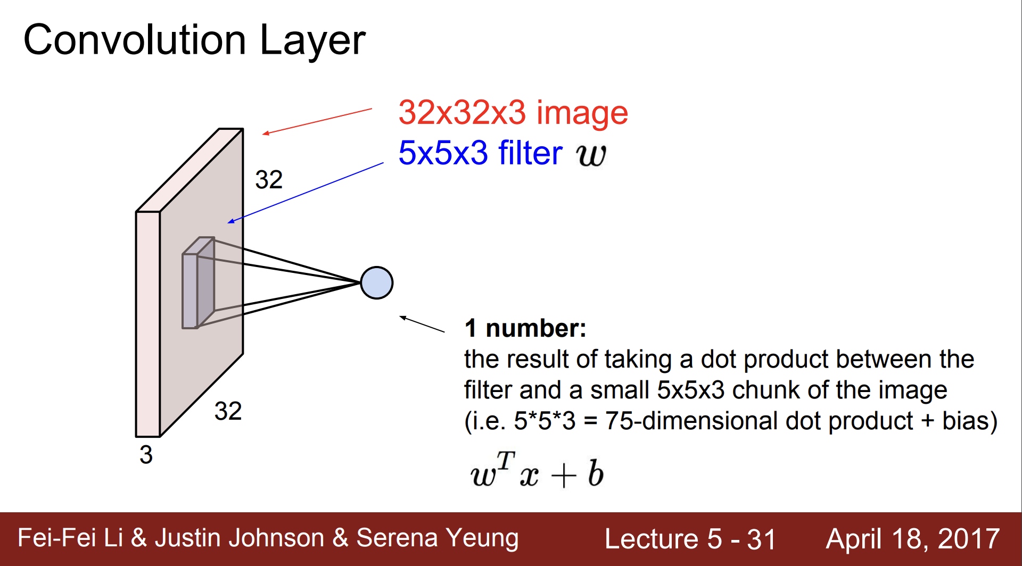

Slide 67
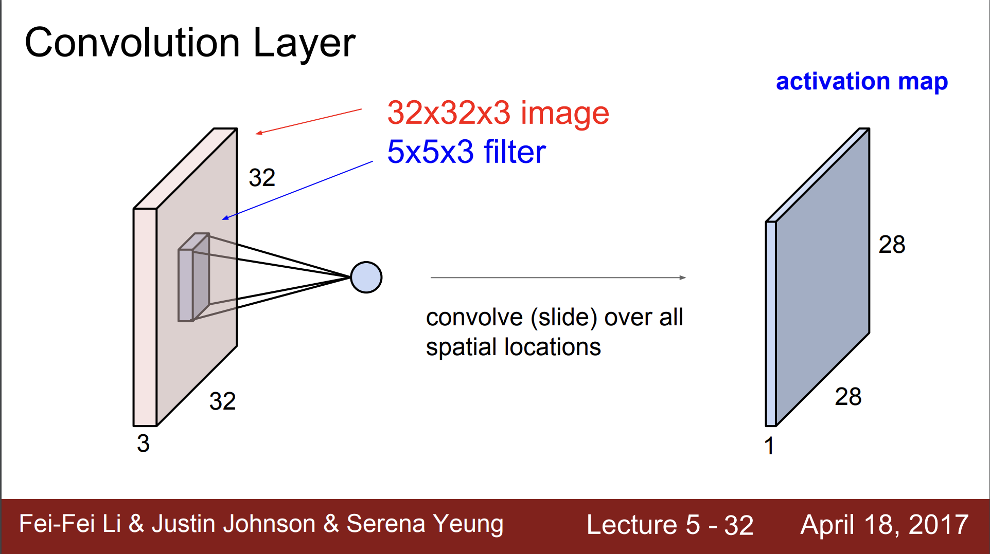

Slide 68
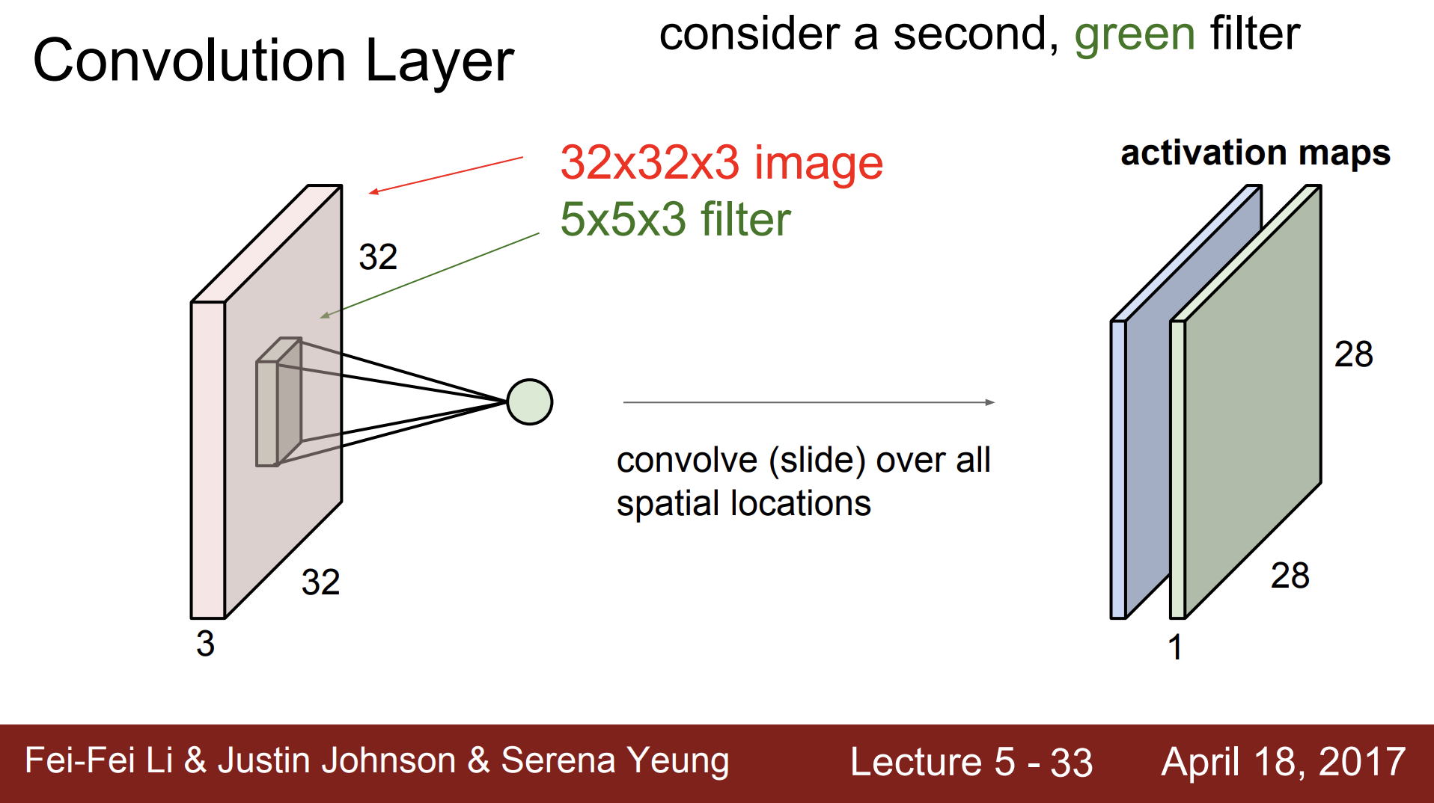

Slide 69
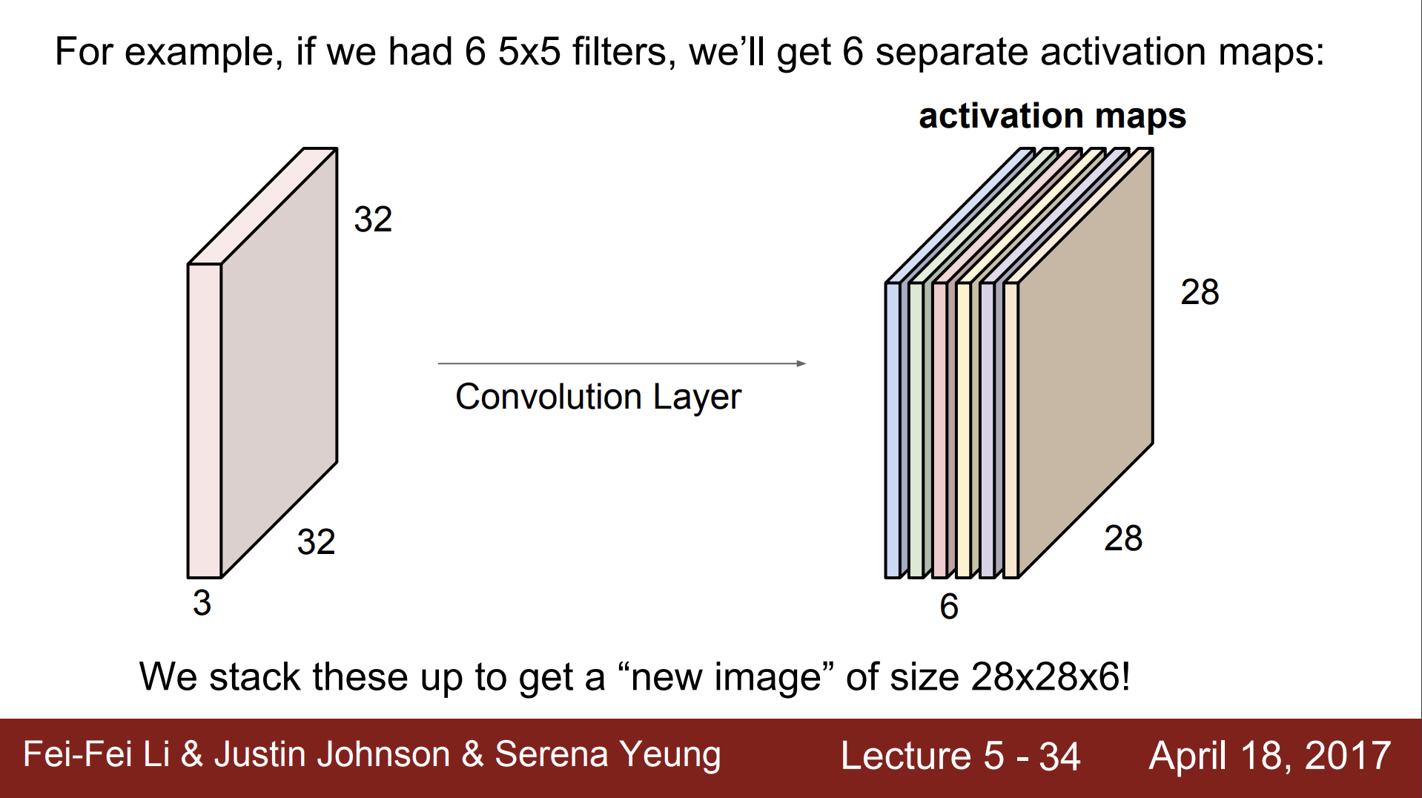

Slide 70
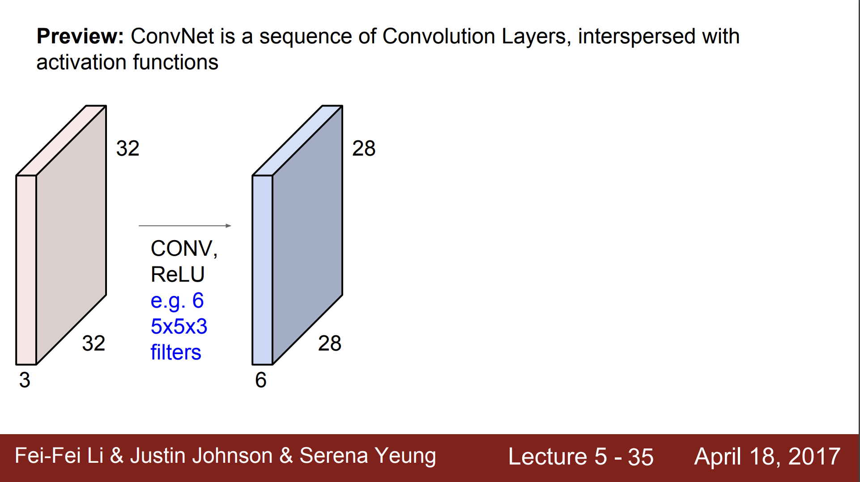

Slide 71
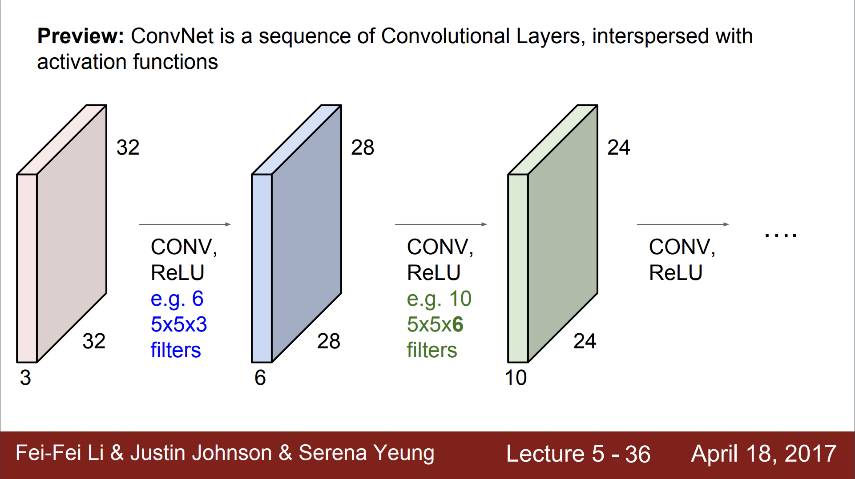

Slide 72
Pooling Layer

Slide 73



Max pooling

Slide 74

Max Pooling in Action
https://github.com/vdumoulin/conv_arithmetic

Slide 75

Avg Pooling in Action
https://github.com/vdumoulin/conv_arithmetic

Slide 76

Max Pooling in Action

Slide 77

Max Pooling in Action (with padding)

Slide 78

Max Pooling with depth of 3

Slide 79

Pooling

Slide 80
Reaons of pooling
Makes the input smaller and more manageable
Reduces the number of parameters and computations in the network,
Makes the network invariant to small transformations, distortions and translations in the input image
Small distortion in input will not change the output of Pooling – since we take the maximum / average value in a local neighborhood).
Helps us arrive at an almost scale invariant representation of our image
We can detect objects in an image no matter where they are located.

Slide 81

Fully Connected
https://github.com/vdumoulin/conv_arithmetic

Slide 82
Fully Connected
The Fully Connected layer is a traditional MLP that uses a softmax activation function in the output layer
The purpose of the Fully Connected layer is to use these features for classifying the input image into various classes based on the training dataset
The sum of FC layers’ probability is 1 ensured by softmax to form a probability distribution.
https://github.com/vdumoulin/conv_arithmetic

Slide 83

實際運算，使用Im2col

Slide 84

CNN

Slide 85


Slide 86

Visualize the CNN

Slide 87


A hand-written digit ‘8’

Slide 88

A hand-written digit ‘8’

Slide 89

A hand-written digit ‘8’

Slide 90


A hand-written digit ‘8’

Slide 91


A hand-written digit ‘8’

Slide 92


Simple CNN

